Slide 1
Comparative Education Index in Turkey: Before and After
CS210 - Introduction to Data Science Project
by Team Sanity Check
Serhan Yılmaz, Bilgehan Bilgin, Beste Bayhan, Mustafa Harun Şendur

Slide 2
The Comparative Education Index
Quantify
Compare
Analyse
Quantifying the state of education in each province in Turkey. Integrating various factors such as the the number of students per teacher, per school, and per classroom, the budget allocated per student, and the Human Development Index (HDI).
Comparing the quantified state of education in every province in Turkey against each other. Visualising disparities and similarities in education quality and accessibility across the country.
Going beyond the comparing, analysis is done to underline the factors contributing to the state of education in each province across time. Further analysis linked with socio-economic factors

Slide 3
Collection of Data
MEB Statistics
United Nations Statistics
Ministry of Treasury and Finance
Student Numbers
Teacher Numbers
School Numbers
Classroom Numbers
Schooling Ratio
The Human Development Index (HDI)
“General Government’s Financial Statistics”
Budgets for each province over years

Slide 4
Our Hypothesis
“There is a significant correlation between the factors of Student per Teacher, Student per School, Student per Classroom, Budget per Student, and the Human Development Index (HDI), and the education index of provinces in Turkey. By leveraging these factors, we claim the COVID-19 pandemic was a major contributor to the Education Accessibility and Quality in Turkey, and has affected poorer, small regions more than metropolitan areas.”

Slide 5
Data Organisation
Data Cleaning and Formatting
Obtaining the data from our data sources
Handling missing data from particular annual statistics
Categorisation of every feature that have been analysed
Interoperating with datasets from different data sources
Derivation of New Functional Data
Created ratios useful for our calculations
Student per Teacher
Student per Classroom
Student per School
Education Budget per Student

Slide 6
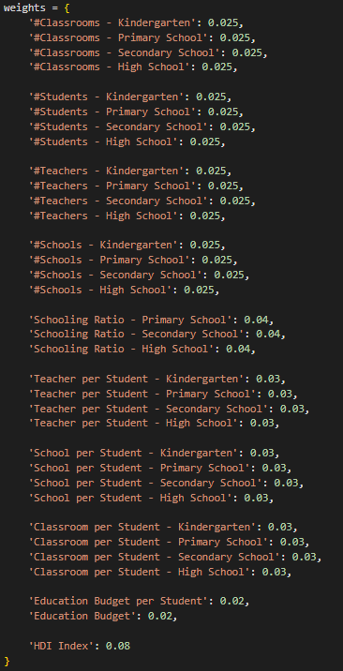
Calculating the Education Index
Determined the weights for the relevant features in our dataset
Normalized the data using the determined weights

Slide 7
Data Visualisation
Histogram - Frequencies of Education Indices
Correlation Heatmap - Analysing the Correlations of Features
Stacked Bar Chart - Numbers of Students & Teachers by Education Level
Scatter Plot - HDI Index & Teacher per Student Correlation
Radial Bar Chart - Education Budget per Province
Scatter Plot - Education Index vs HDI Index

Slide 8

Data Visualisation
Examining the Visualised Data

Slide 9
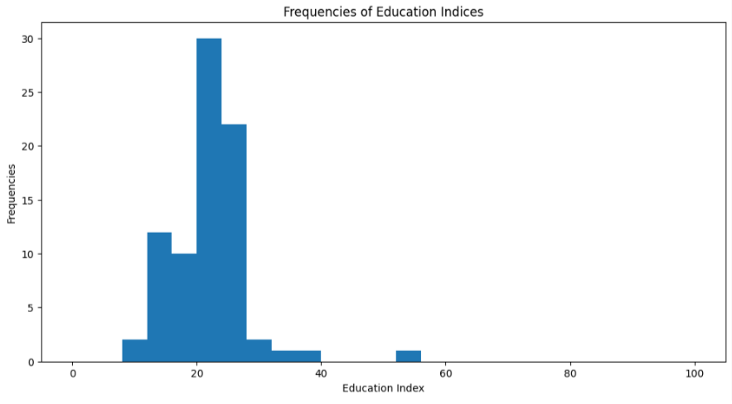

Slide 10
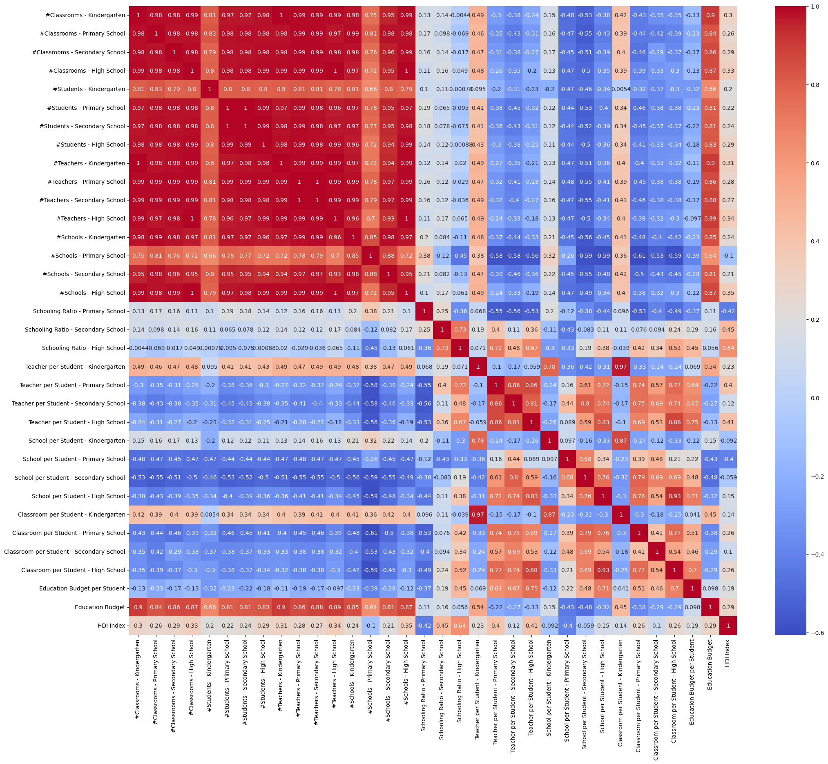
Correlation Heatmap - Analysing the Correlations of Features
Notes:
2014 graphs

Slide 11
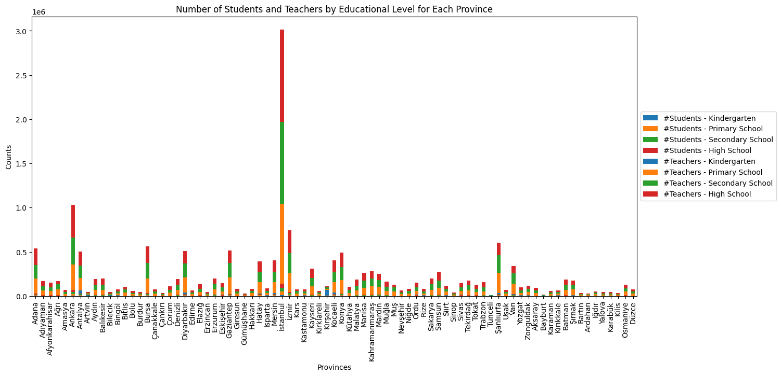
Stacked Bar Chart - Numbers of Students & Teachers by Education Level

Slide 12
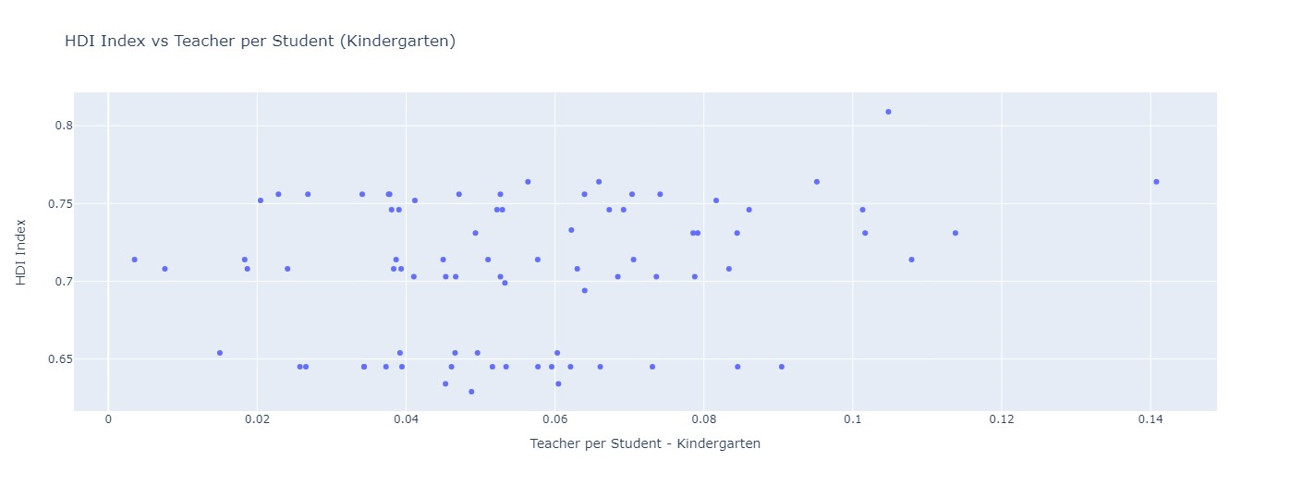
Scatter Plot - HDI Index & Teacher per Student Correlation - Kindergarten

Slide 13
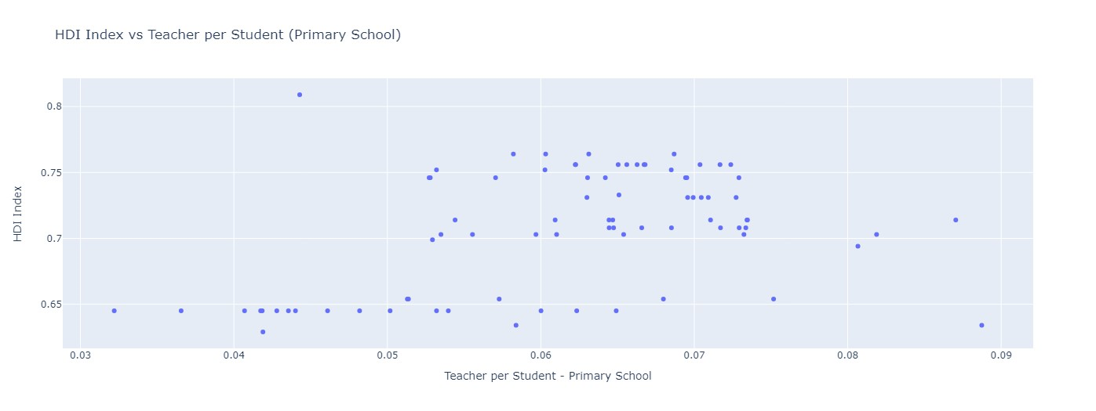
Scatter Plot - HDI Index & Teacher per Student Correlation - Primary School

Slide 14
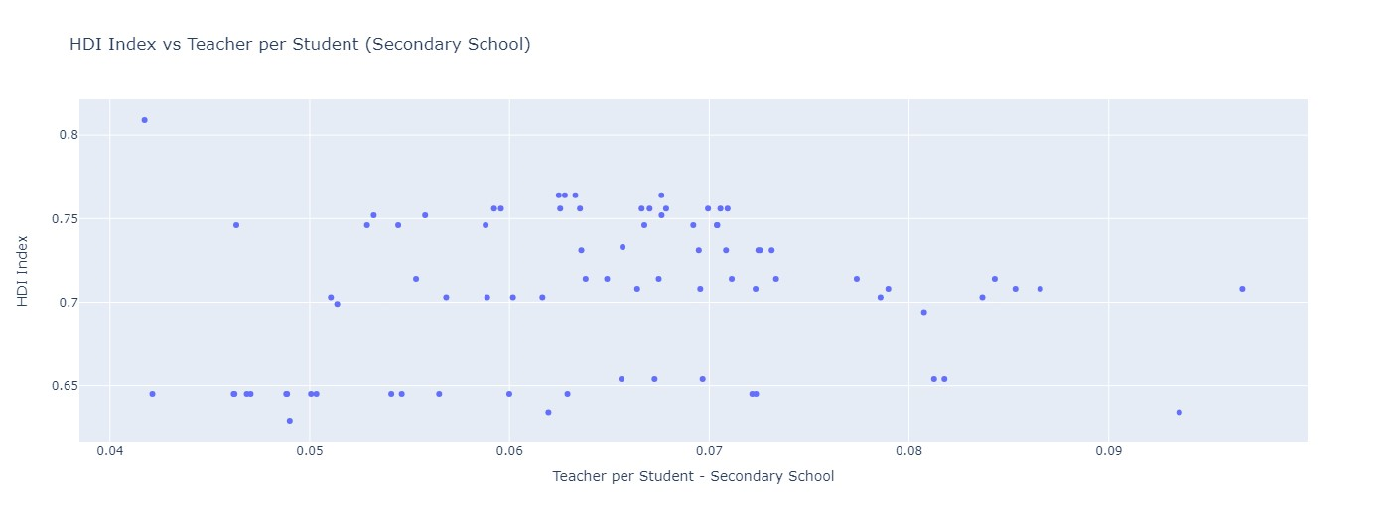
Scatter Plot - HDI Index & Teacher per Student Correlation - Secondary School

Slide 15
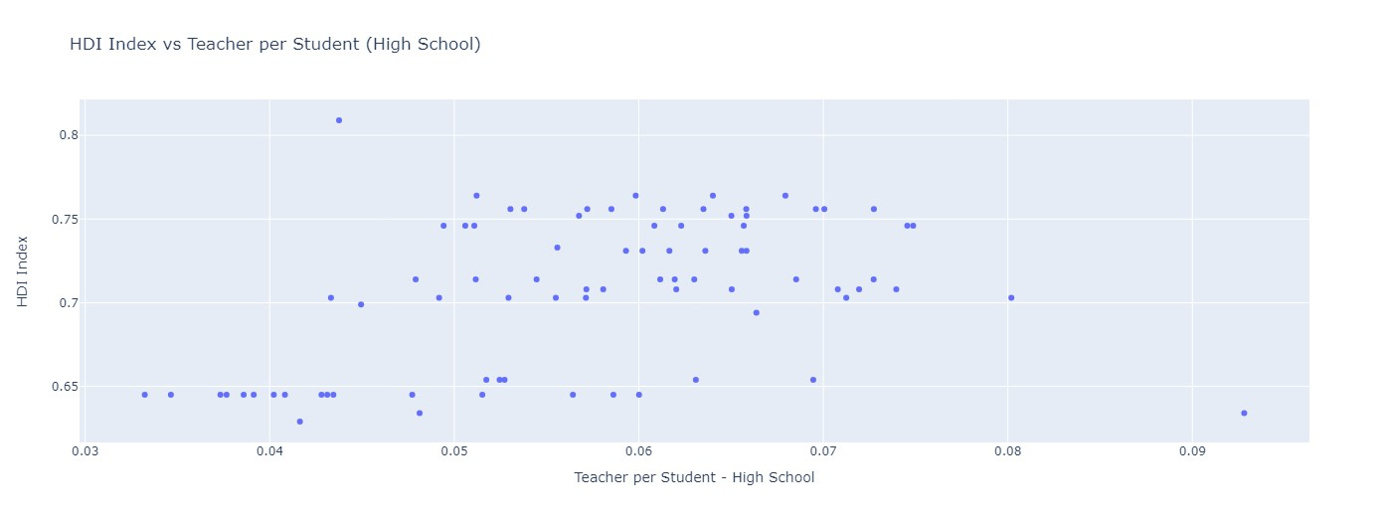
Scatter Plot - HDI Index & Teacher per Student Correlation - High School

Slide 16
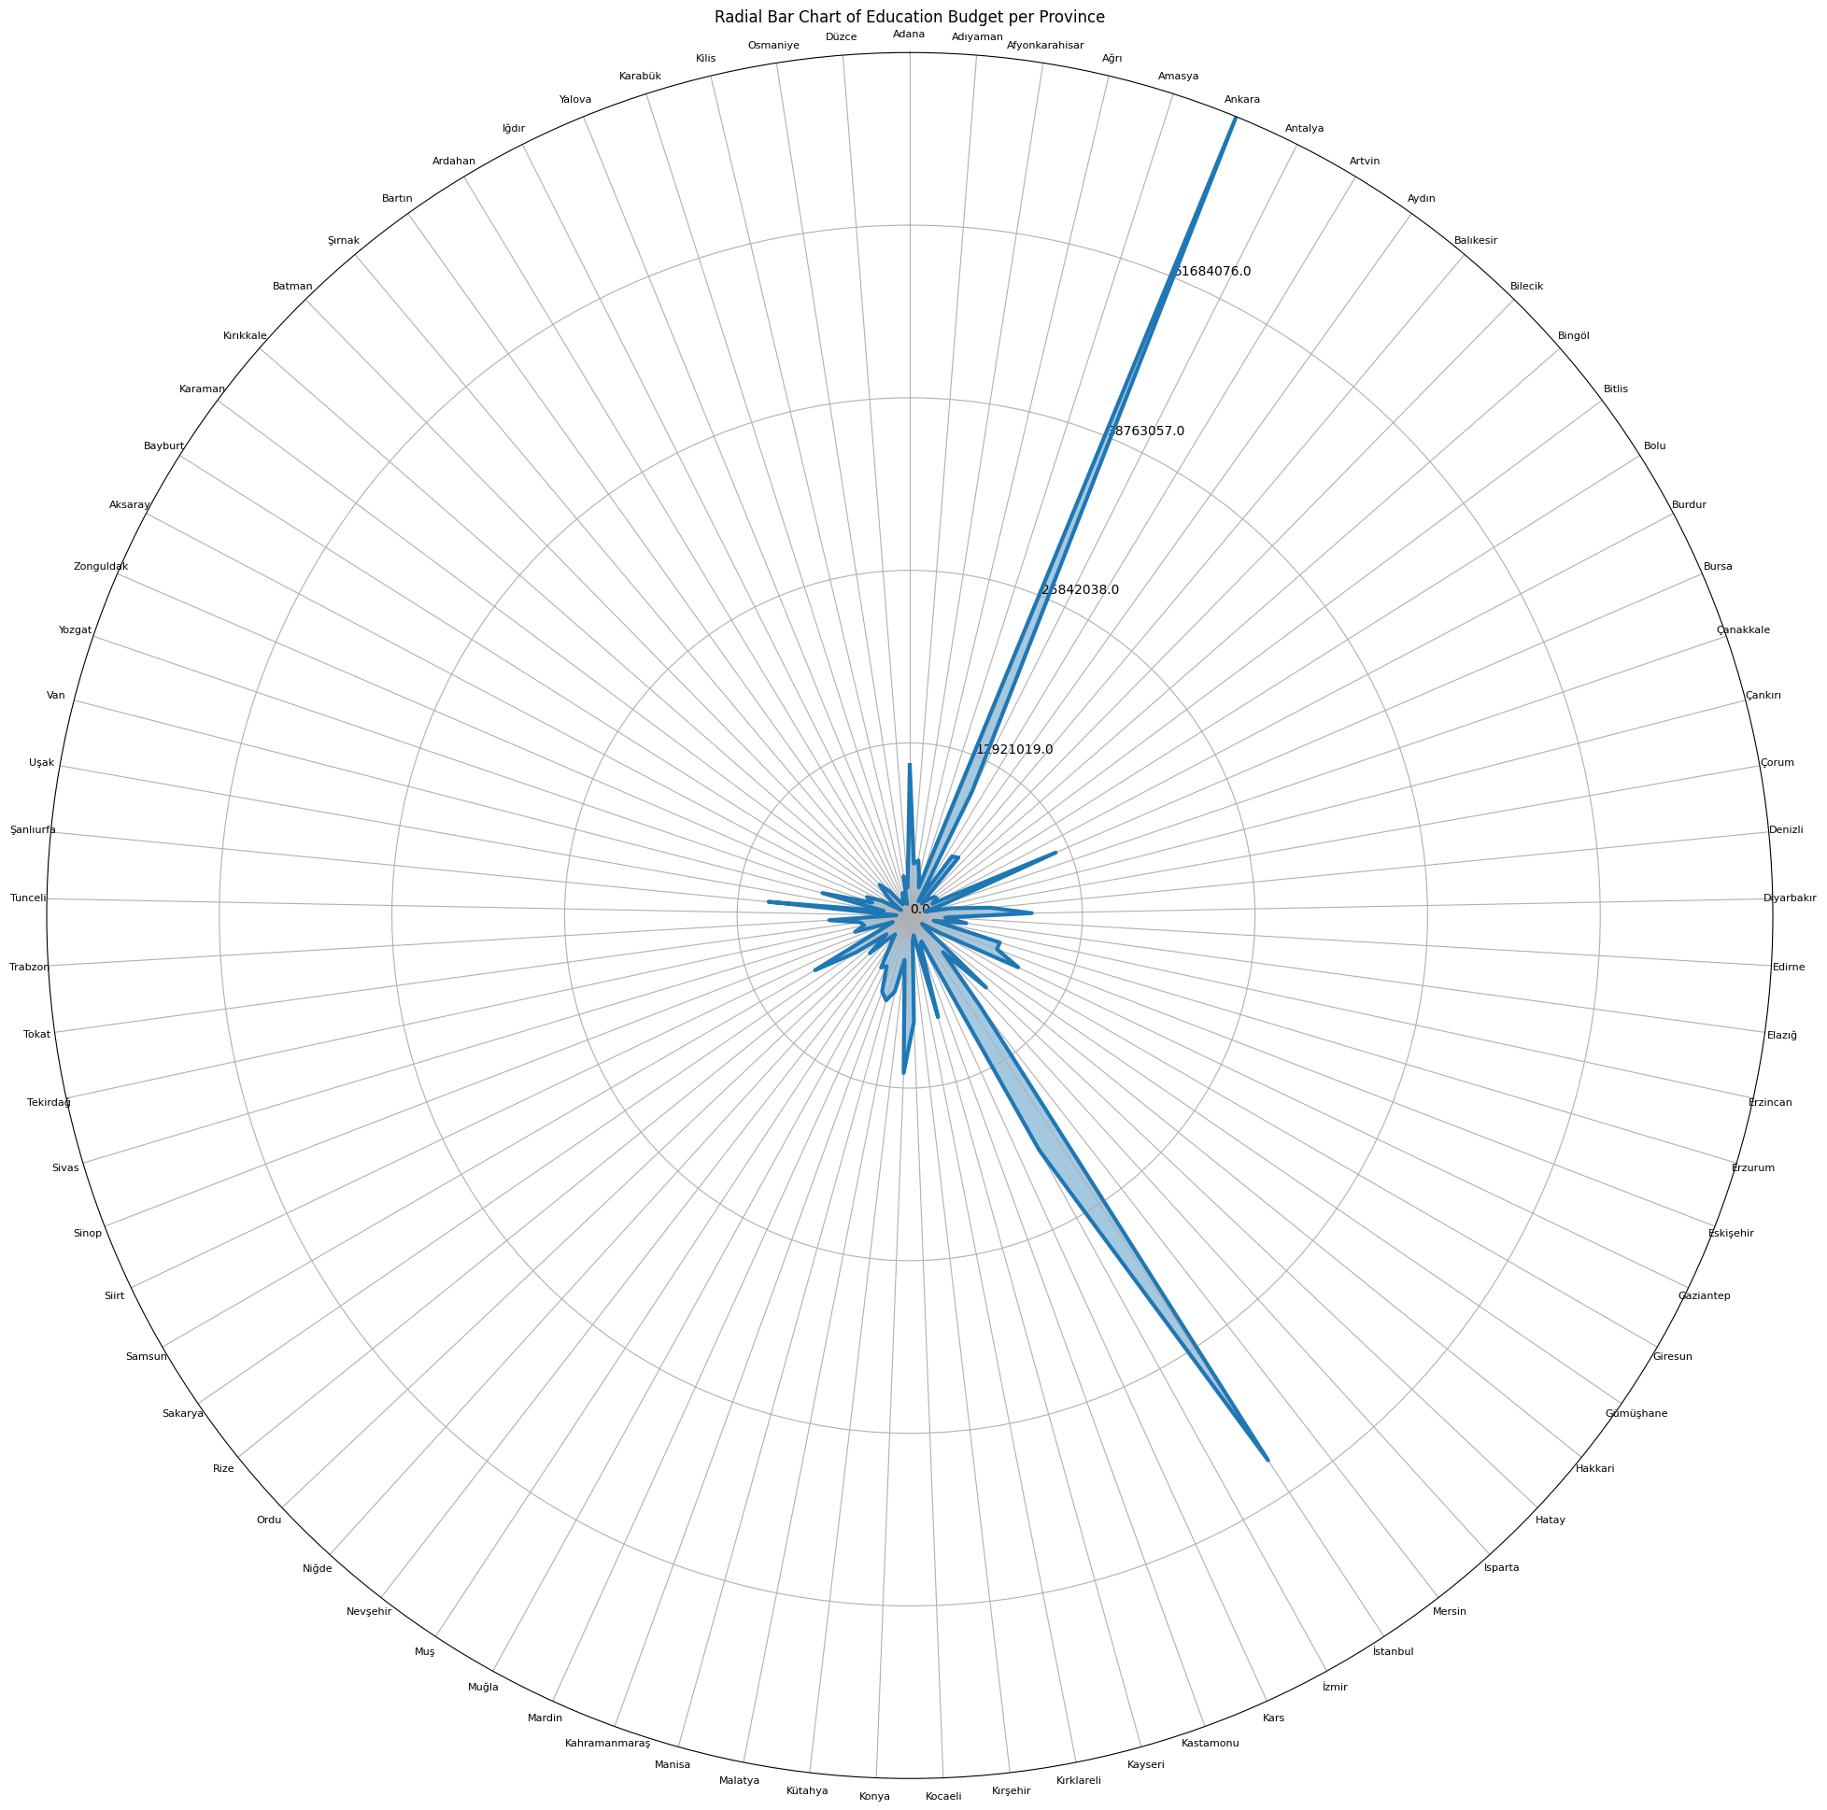
Radial Bar Chart - Education Budget per Province

Slide 17
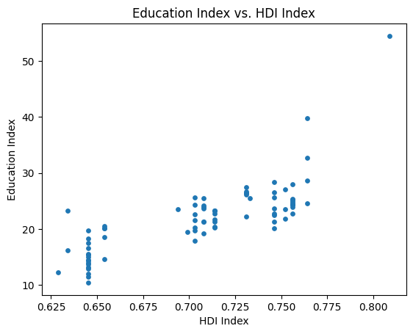
Scatter Plot - Education Index vs HDI Index

Slide 18
Training an ML Model

Slide 19
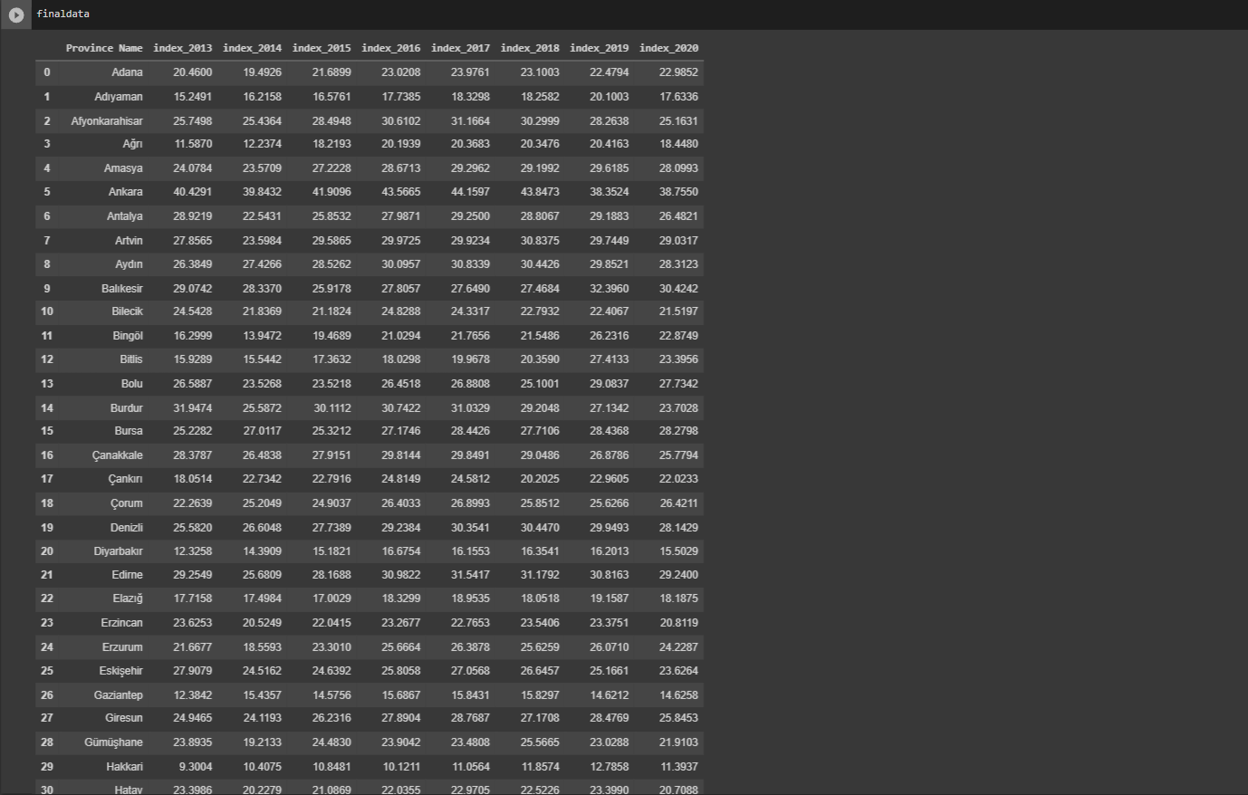
Education Indices - 2013 through 2020

Slide 20
Splitting Data into Training and Testing Sets
Predicting the education index for the particular year
Visualising the data using scatter plot to present predicted & actual values
Preprocessing & Preparing Data
Training the ML Model
Predicting Education Index
Calculating the Accuracy
Visualise and Report
Using Linear Regression
Calculating and Reporting the Model’s Accuracy

Slide 21
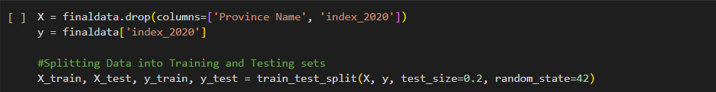
Preprocessing & Preparing Data for
Training - Testing

Slide 22
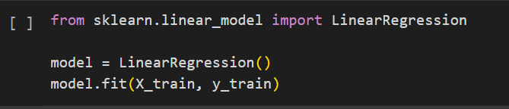
Training an ML Model - Linear Regression

Slide 23

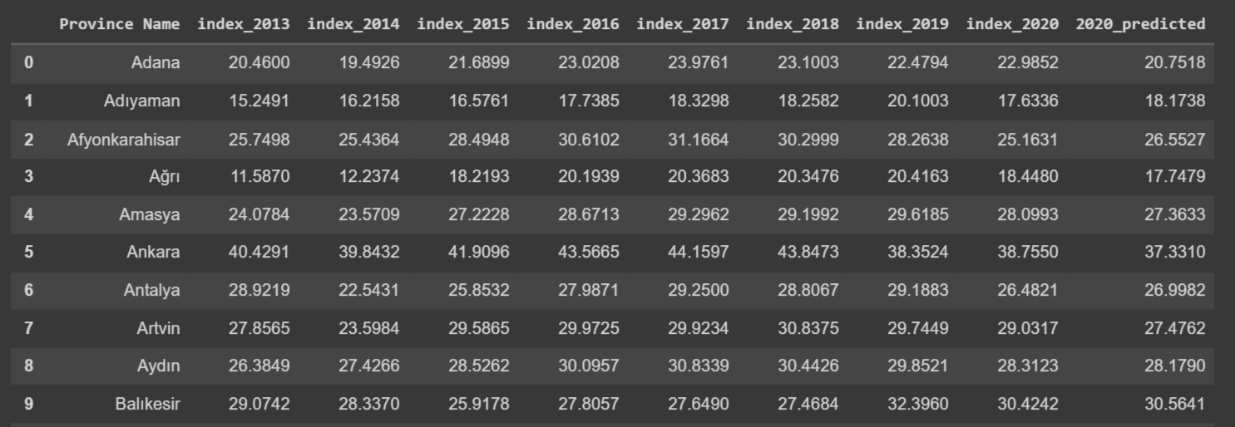
Predicting Education Index for 2020

Slide 24
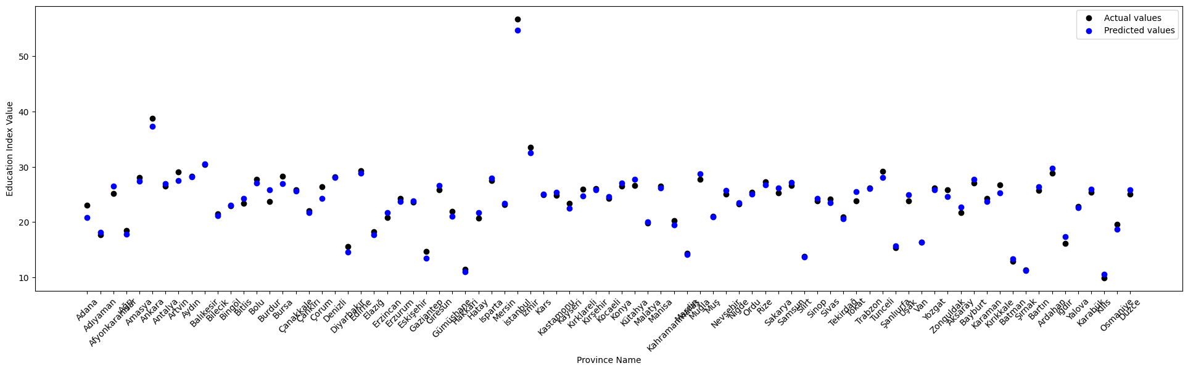
Calculate and Report the Model’s Accuracy
Our model has an R-squared score of
0.9795 for the Training Set
0.9806 for the Testing Set

Slide 25
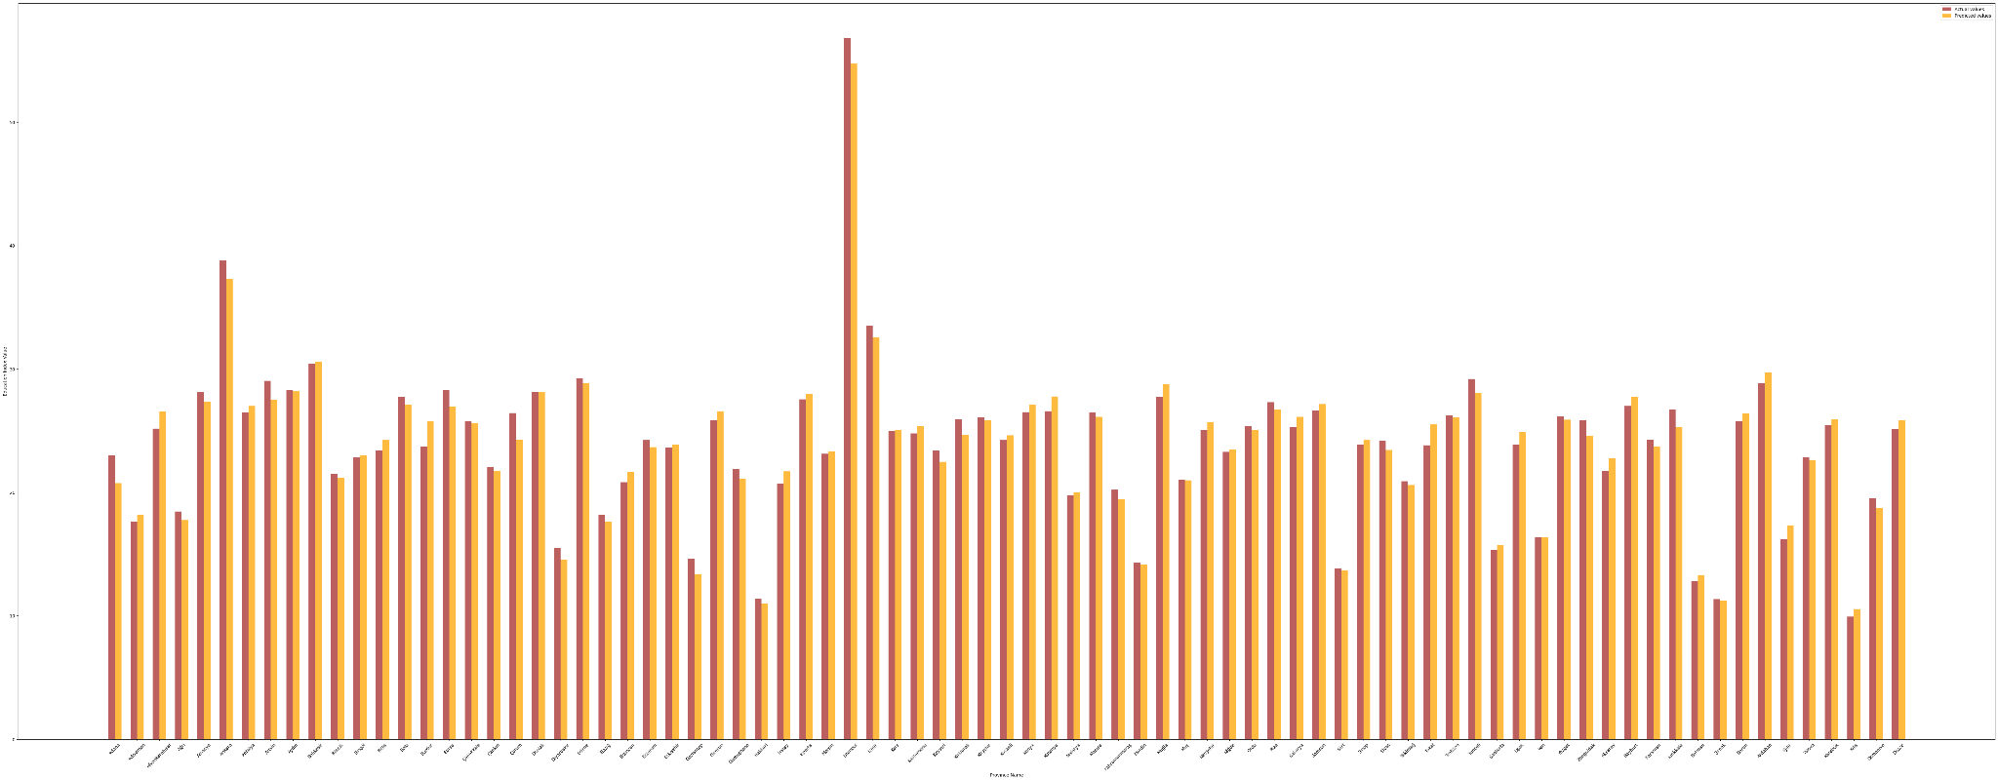
Bar Chart with Predicted Index vs Actual Index for 2020

Slide 26
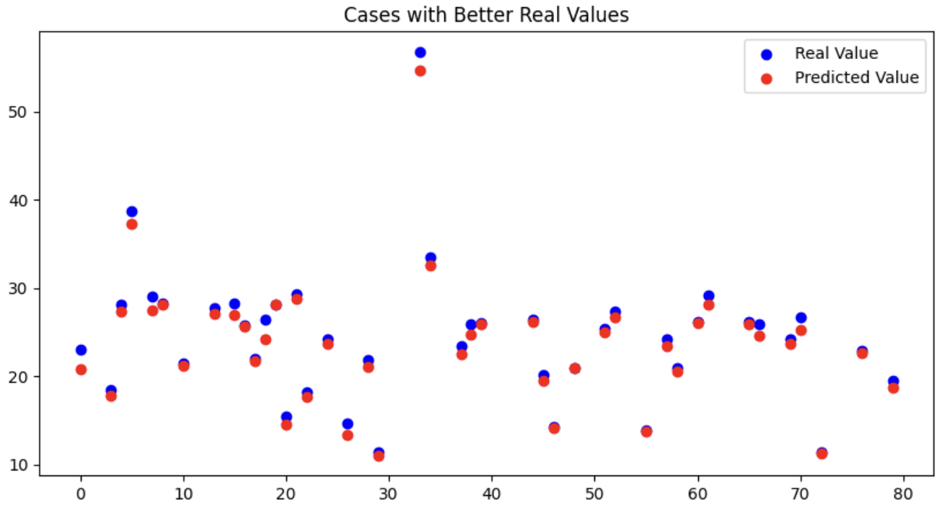
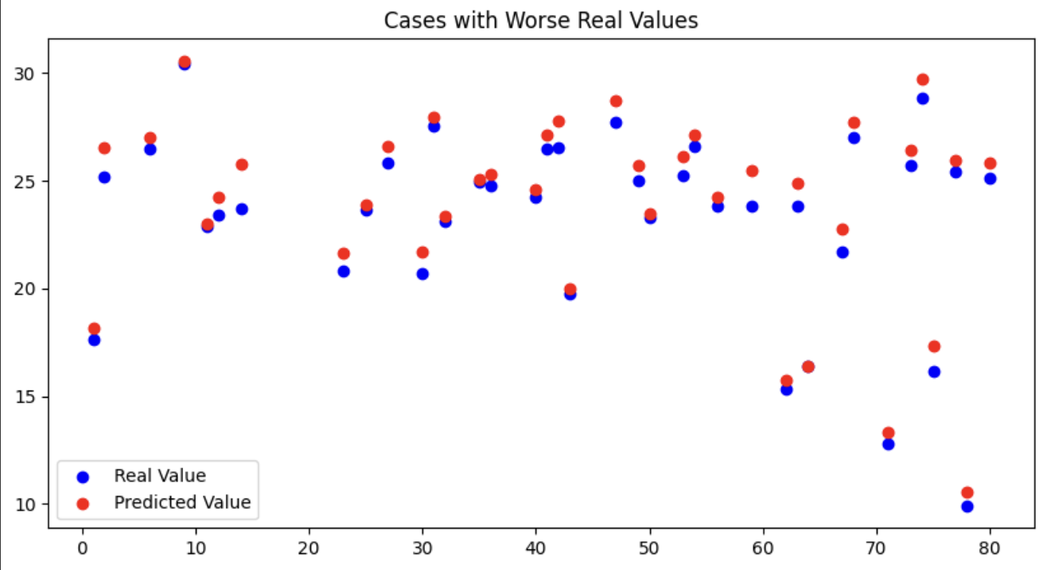
Reality vs Expectation - Better or Worse

Slide 27
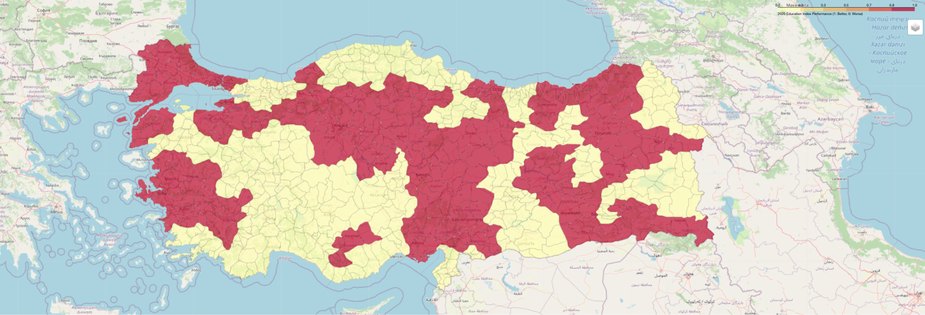
Map

Slide 28
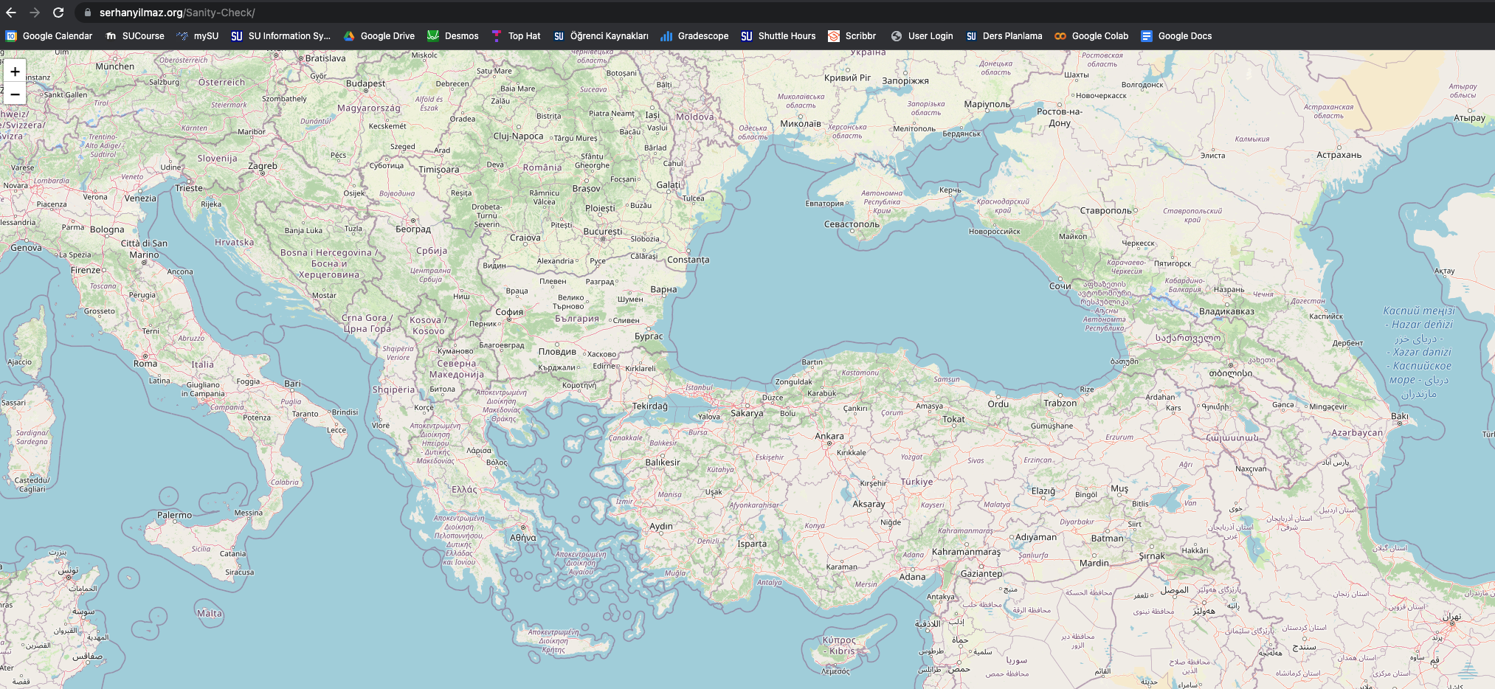
Website
Work in progress!

Slide 29
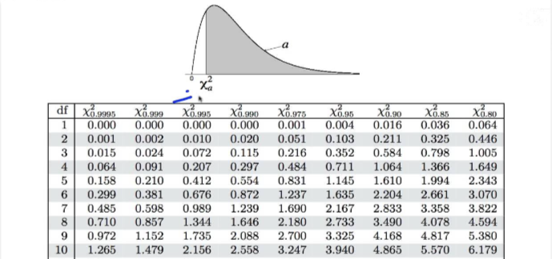
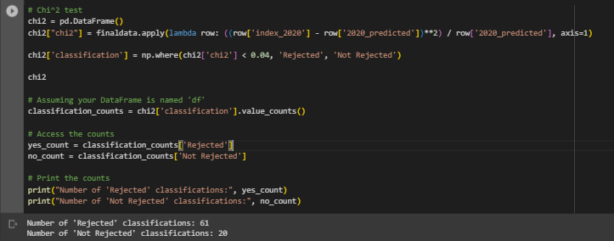
Conclusion
Based on our analysis of Education Index by Province over years we observed that:
There were 61 cities where the education index for 2020 fell dramatically
There were 20 cities where the education index for 2020 was relatively as expected
There could be many other factors…
But we suspect the pandemic was probably the major contributor

Slide 30
Thank You For Listening
Team Sanity Check

